Slide 1
Project Title:
Bank Management System
M.S. Ramaiah Institute of Technology
(Autonomous Institute, Affiliated to VTU)
Department of Computer Science and Engineering
Course Name: Microservices
Course Code:CSL74
Under the guidance of
Dr. Geetha J
Associate Professor,
Dept. of CSE,MSRIT
By:
ARJUN (1MS22CS033)
BASAVARAJ(1MS22CS041)

Slide 2
Agenda
Application Overview Microservices Architecture List of microservices Communication method Database per service System Architecture Overview High-level microservices architecture diagram Interaction between services Service Discovery & Configuration API Gateway Design challenges Deployment and monitoring challenges

Slide 3
Application Overview
Application Name:
Bank Management System (Banking Simulator)
Problem Statement:
Traditional monolithic banking systems are difficult to scale and deploy without downtime.
Why Microservices?
Scalability: Scale high-traffic services like transactions independently
Independent Deployment: Update one service without redeploying the entire system
Fault Isolation: Failure in one service doesn’t crash the whole system

Slide 4
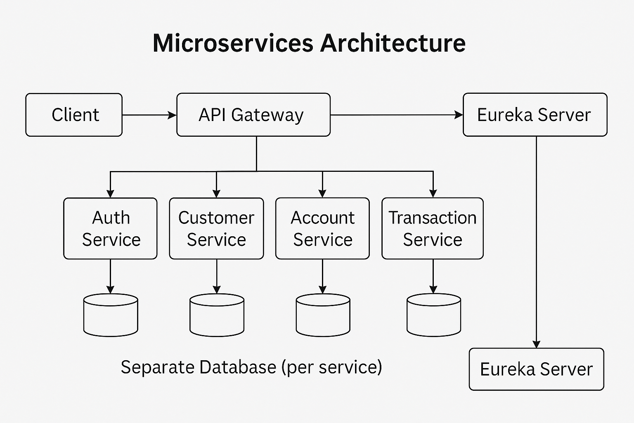
Microservices Architecture

Slide 5
List of microservices
Service Name | Responsibility
Auth Service | User login, registration, JWT, PIN validation
Customer Service | Customer profile management
Account Service | Account creation, balance management
Transaction Service | Deposit, withdraw, transfer
API Gateway | Routing and request handling
Eureka Server | Service discovery

Slide 6
Communication method
Inter-Service Communication:
REST API over HTTP
Synchronous communication
Spring WebClient used for service-to-service calls
Why REST?
Simple to implement
Easy debugging
Immediate response to users

Slide 7
Database per service
Service | Database
Auth Service | auth_db
Customer Service | customer_db
Account Service | account_db
Transaction Service | transaction_db
Benefits:
No shared database
Better data isolation
Independent schema changes

Slide 8
System Architecture Overview
Layers:
Client Layer (React Frontend)
API Gateway Layer
Microservices Layer
Database Layer
Service Discovery Layer (Eureka)
Flow:
Client → API Gateway → Microservices → Databases

Slide 9
High-level microservices architecture diagram
Components Included:
React Frontend
API Gateway
Auth, Customer, Account, Transaction Services
Individual Databases
Eureka Server

Slide 10
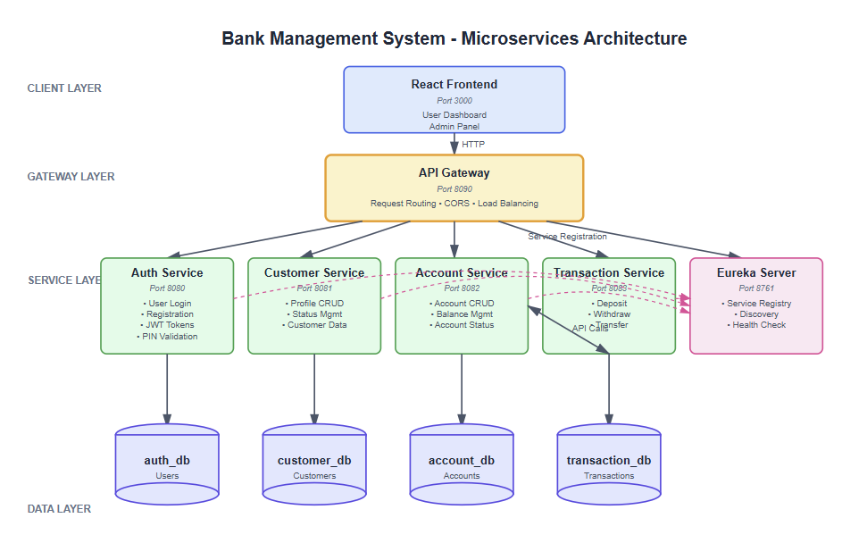
High-level microservices architecture diagram

Slide 11
Interaction between services
Example: Money Transfer Flow
User initiates transfer
Request goes through API Gateway
Transaction Service handles request
Auth Service validates PIN
Account Service updates balances
Transaction record saved
Success response returned

Slide 12
Service Discovery & Configuration
Service Discovery:
Configuration Approach:
Each microservice has a separate application.yml file.
Services use a shared JWT secret and dynamic service URLs.
Uses Netflix Eureka Server for service registration.
API Gateway uses Eureka to discover and route services.

Slide 13
API Gateway
Role of API Gateway
Single entry point: Acts as the only access point for all client requests.
Routes requests to services: Directs incoming requests to the correct microservice.
Load balancing using Eureka: Distributes requests across available service instances.
CORS handling: Manages cross-origin requests centrally.
Benefits
Frontend uses only one URL: Clients interact with a single endpoint instead of multiple services.
Centralized security & routing: Security checks and routing logic are handled in one place.
Simplified client communication: Reduces complexity by hiding internal service details from clients.

Slide 14
Design challenges
Challenge | Description | Solution
Data Consistency | No shared DB | Eventual consistency
Distributed Transactions | Transfer across services | Saga pattern
Service Failure | One service down | Graceful failure handling
Authentication | JWT validation | Shared secret key

Slide 15
Deployment and monitoring challenges
Deployment Challenges:
Multiple services and ports
Startup order dependency
Database setup per service
Monitoring Challenges:
Distributed logs
Request tracing
Service health monitoring

Slide 16
Conclusion
The Bank Management System using microservices improves scalability, flexibility, and reliability by dividing the application into independent services. Each service can be deployed and scaled separately, making the system easier to manage and enhance compared to a monolithic architecture.

